Slide 1
Certified Community Behavioral Health Clinic
Megan Wilcox, MSW
Chalee Rivers, RN
Grace White, RN, APHN-BC
January 16, 2019

Slide 2
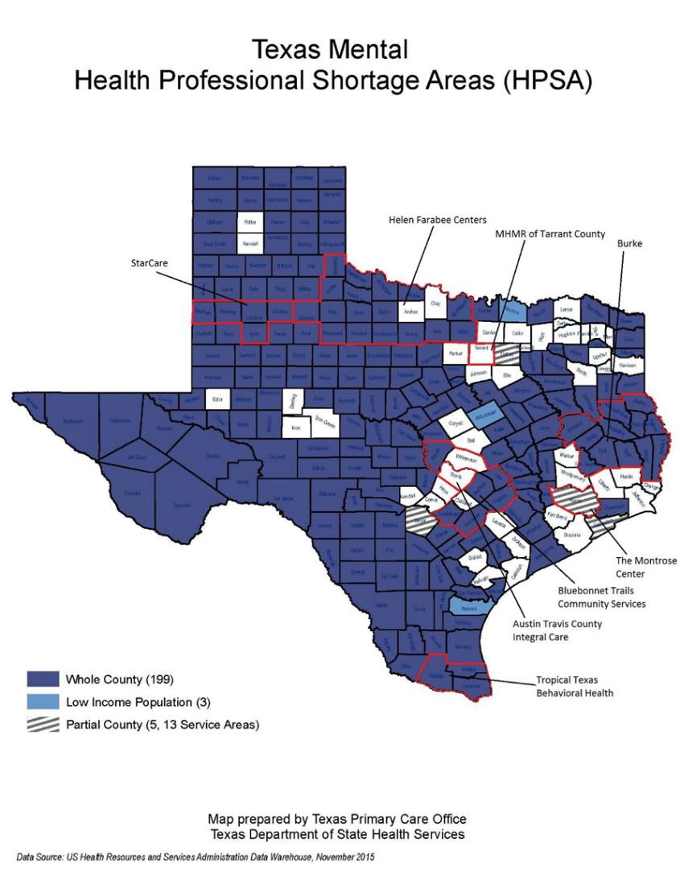
History of CCBHC
2016: 8 CCBHC Pilot States
2017: 8 “Texas” CCBHCs
CCBHC as the future of Behavioral Healthcare in Texas
CCBHC

Slide 3
CCBHC Program Requirements
PR1: Staffing
PR2: Availability & Accessibility of Services
PR3: Care Coordination
PR4: Scope of Services
PR5: Quality & Other Reporting
PR6: Organizational Authority, Governance and Accreditation
CCBHC

Slide 4
PR1: Staffing
Needs Assessment
Staffing Patterns
Workflows
Credentialing
Training
Cultural Competency
CCBHC

Slide 5
PR2: Availability & Accessibility of Services
How individuals enter into services
Time to initial evaluation
Crisis prevention and response (24 hours)
Eligibility for services
Sliding fee scale
CCBHC

Slide 6
PR3: Care Coordination
Care Coordination is “linchpin” of CCBHC
Integration of mental health, substance use, physical health, and social services
Follow-up after hospitalization
Electronic Health Record (EHR) to track activities
CCBHC

Slide 7
PR4: Scope of Services
Nine Required CCBHC Services
Crisis Mental Health Services
Screening, assessment, and diagnosis, including risk assessment
Patient-centered treatment planning
Outpatient mental health and substance use services
Using evidence-based practices
Outpatient clinic primary care screening and monitoring of key health indicators and health risk
Targeted case management
Psychiatric rehabilitation services
Peer support and counselor services and family supports
Intensive, community-based mental health care for members of the armed forces and veterans
CCBHC

Slide 8
PR5: Quality & Other Reporting
Nine Clinic Reported Measures
Time to Initial Evaluation
Preventive Care & Screening: Adult Body Mass Index (BMI) Screening and Follow-up
Weight Assessment and Counseling for Nutrition and Physical Activity for Children & Adolescents
Preventive Care & Screening: Tobacco Use: Screening & Cessation Intervention
Preventive Care & Screening: Unhealthy Alcohol Use: Screening & Brief Counseling
Child & Adolescent Major Depressive Disorder: Suicide Risk Assessment
Adult Major Depressive Disorder: Suicide Risk Assessment
Screening for Clinical Depression & Follow-up Plan
Depression Remission at Twelve Months
CCBHC

Slide 9
PR5: Quality & Other Reporting
12 State Reported Measures
Housing Status
Follow-up after Emergency Department for Mental Health
Follow-up after Emergency Department for Alcohol or Other Dependence
Plan All-Cause Readmission Rate
Diabetes Screening for People with Schizophrenia or Bipolar Disorder who are Using Antipsychotic Medications
Adherence to Antipsychotic Medications for Individuals with Schizophrenia
Follow-up after Hospitalization for Mental Illness, ages 21+
Follow-up after Hospitalization for Mental Illness, ages 6-21
Follow-up Care for Children Prescribed ADHD Medication
Antidepressant Medication Management
Initiation and Engagement of Alcohol and Other Drug Dependence Treatment
Patient & Family Experience of Care Survey
CCBHC

Slide 10
PR5: Quality & Other Reporting
Cost Report
Continuous Quality Improvement Plan
Consumer suicide deaths or suicide attempts
Consumer 30 day hospital readmissions for psychiatric or substance use reasons
CCBHC

Slide 11
PR6: Organizational Authority, Governance & Accreditation
Non-profit, local government BH authority, operate under authority of Indian Health Service
Annual financial audit
Board membership
Nationally recognized accreditation
Joint Commission
CARF
COA
AAAHC
CCBHC

Slide 12
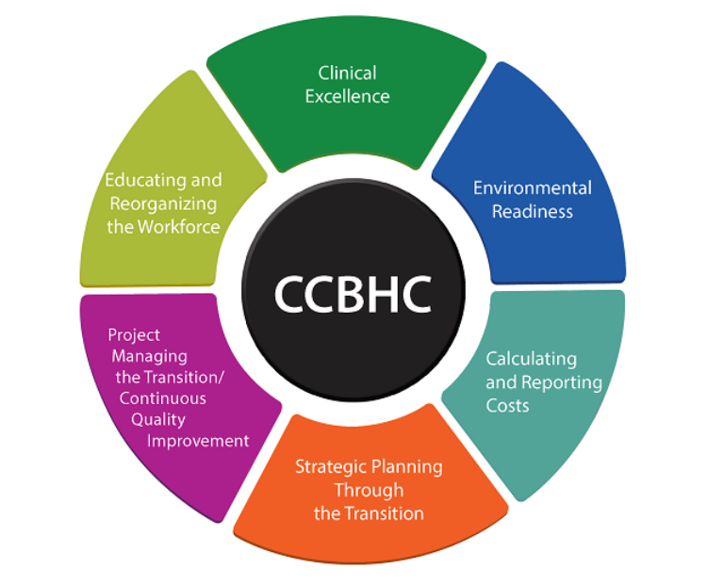
Resources
National Council for Behavioral Health
SAMHSA
CCBHC

